Slide 1

STAGE - II

Slide 2

Summary
01
Startup name
07
Technical Details
02
One line about Idea
08
Research done so far
03
Problem Statement
09
Consumer Segments
Solution
Channels/ Marketing strategies
04
10
05
Your Innovation
11
Revenue model
06
Working Model
12
Milestones
13
Team Infomation

Slide 3

STARTUP NAME
SocioSolutions

Slide 4
Briefly describe your idea
Our idea is to develop a solution which resists/stops the spreading of adult content, abusive content and fake content in social media platform such as twitter, Instagram, Facebook etc.

Slide 5

Problem statement
As the usage of social media has been increased enormously these days, we are not aware of the content shared in each social media. With the rapid development of face synthesis technology, the security threat brought by face tampering is becoming more and more serious. It is a fact that we are exposed to adult content, abusive content and fake content. In today’s digital world we see many instances where a particular person is being targeted. Hence we have came with an idea to overcome this problem.

Slide 6

Our main objective is to curb adult content, abusive content and deepfake content in the social media platform.
Our project proposes the solution to detect adult content, abusive content and the content that is against to the community guidelines and most importantly will curb such bullying/harassment in cyber space.
Our solution will work on
social media such as Twitter, Facebook, Instagram etc.
will alarm the authorities about the issue.
the end user who is being posted in the social media will notified and has a facility to report such incidents to the authority.
Solution

Slide 7

Your Innovation
(Unique Value Proposition)
If a person is being face tempered and posted in social media, the end user who is being affected will be notified about this and the person who posted the fake content will also get notified.
Apart from detecting whether the content is fake or real, our detection algorithm provides a probability whether it is deep fake or not. If the probability of deepfake is high, it automatically intimates the user about it and resists the user to upload the content and also notifies the actual one who is in the content.

Slide 8
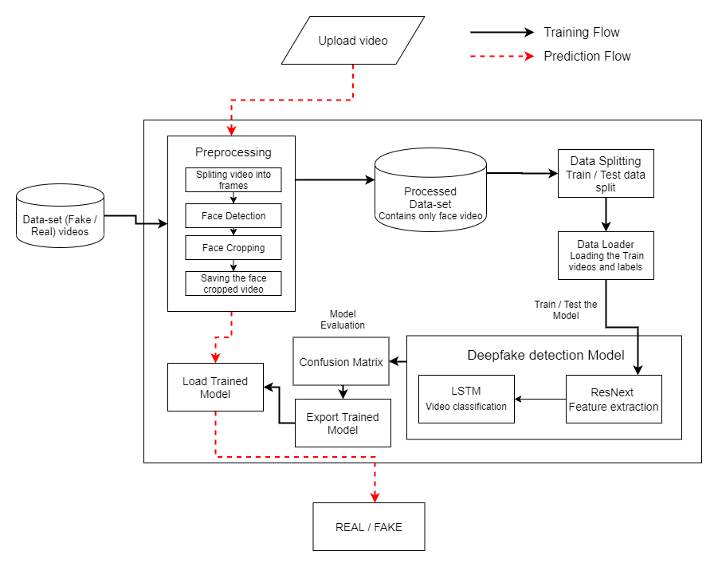
Working model:

Slide 9
Process:
Once when the user uploads the content to any social media, our algorithm checks for any hate content with our algorithm.
Once any harmful content found, it sends a alert message to the user. It also sends a notification to the person who is being misused in the content.
The end user has the access to report the content and the user.
Our Prototype Model:
Video Demo: https://github.com/SURYASTIC/tnsi-demo-workspace

Slide 10
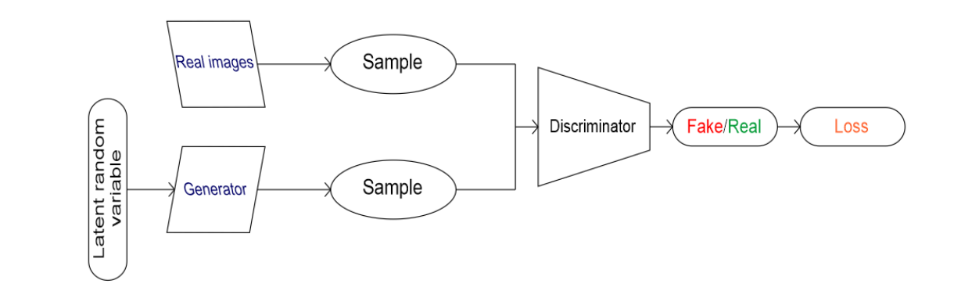
Technical details
Once the user uploads the video, the uploaded video is being split into frames:
Each frames that have been split will be checked for harmful content (adult content) which are against to the community. If it is a harmful content, it automatically intimates the user about the uploaded content and restricts the user to upload the content.
The face was detected in each frames. If the probability of the content being Deepfake is high, it automatically intimates the user about the uploaded content(fake content) and restricts the user to upload the content using our Deep Learning algorithm. Hence spreading of Deepfake content can be drastically minimized.
REQUIREMENTS:
Programming Language – Python
Library :
Open CV
Keras
Tensorflow
Detection:
Dlib
FaceNet
MTCNN
Cloud Service:
AWS

Slide 11
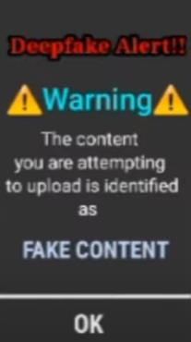
Research done so far
An innovation process always starts with the search for and finding innovative potentials and the derivation of ideas. First we thought of detecting the harmful content, while the development was going on we came to an innovative idea of intimating the user about their content using our algorithm which will be much more feasible for this problem.
We have developed a initial prototype and took video of the model to show the working of the model. We are in the development stage of our prototype.
Our solution is expected to work on social media. It should notify the authorities and end users will have the facilities to report the harmful content if uploaded.
We have took survey analysis about our project, we got more positive comments about our project.

Slide 12
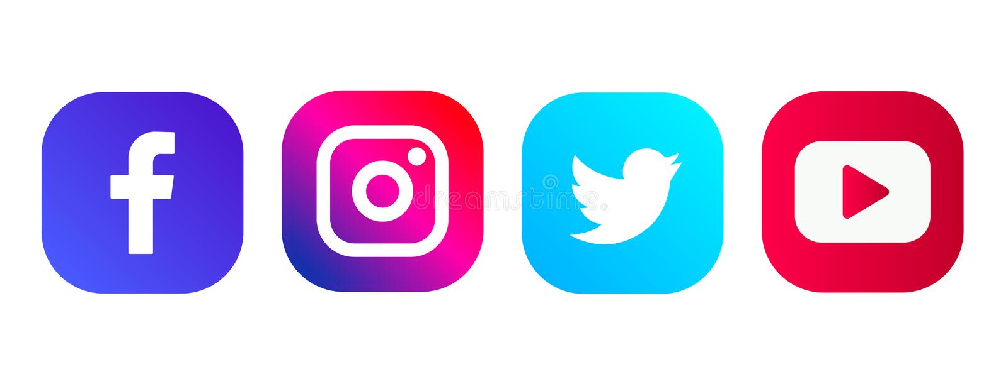
Consumer Segments
Our product is B2B sector based product, hence we are targeting the social media companies like Instagram, Facebook, twitter etc.,. as our customers. This solution will improve the standard of social media, so the users of social media will increase tremendously. So the users will trust the social media thereby it would be beneficial for social media.
We have took survey on our project and got almost positive reviews. And we have got some suggestions in our project and we will consider the suggestions.

Slide 13
Channels/ Marketing strategies
Initially we develop our own social media platform which contains our advantage of our project(resisting of fake and harmful content) to show how our project actually works.
Our social media will be presented as a demo to the existing social media to provide a clear idea about our project.
Thereby the other social media will get an idea about our project.
We will market our project by approaching the social media directly.

Slide 14
Revenue Stream
Our product is directly sold to the social media companies, the revenue of the product can be earned via license based.
The cost of our project depends on our start up at the time of publishing the product in the market.
The company can buy the lifetime licence at the starting stage, or can renew his licence after a year in the yearly basis. Since our product is a software, the cost of product will be finalized at a time of launching.

Slide 15
Cost Structure:
As we are developing a software, investment and the cost of requirements in minimum. All the requirements are available in open source, the hard work done to develop the project costs.
Cost Structure:
AWS – ₹3000/year
Internet costs.

Slide 16
Milestones
To improve the standard of social media.
To Stop the spreading of fake and harmful contents into social media.
To attract more number of peoples towards social media.
Help every user to experience the (benefits of) harmless social media environment.

Slide 17
Team Info
Name of Individuals
cssuryanarayanan2k2@gmail.com
Email
w
Whatsapp - 9003529089
Social Media
99
+91 9003529089
Call us
https://github.com/SURYASTIC/tnsi-demo-workspace
One minute pitching video link:

